Slide 1
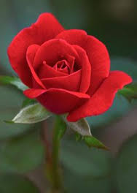
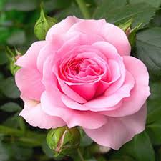

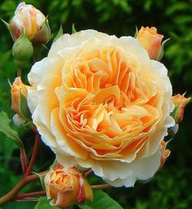
Welcome

Slide 2
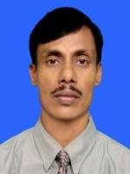
Teacher’s identity
Md. Monirul Islam
Lecturer in English
Adarsha Mohila Degree College
Kumarkhali

Slide 4
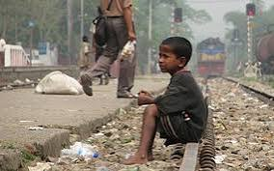
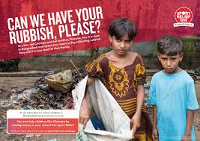
Look at the pictures below:

Slide 5
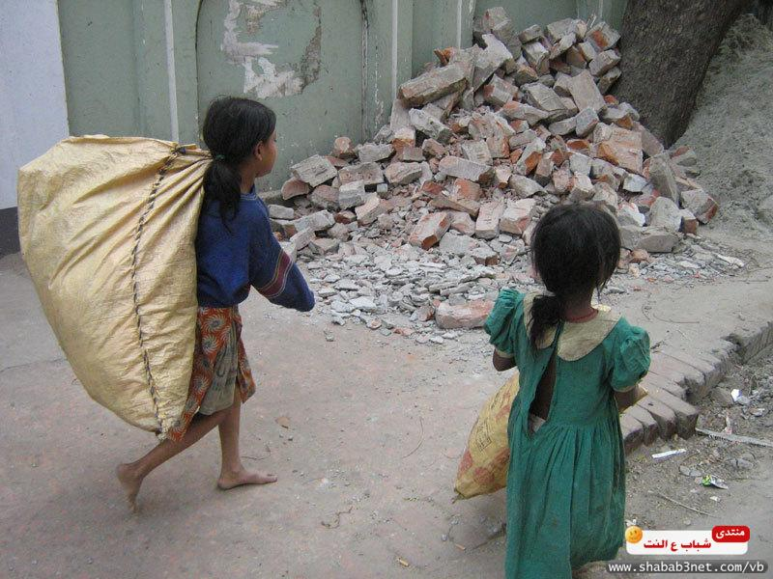

Slide 6
Now think over the questions below:
Who do you think are these children? What would you call them in your own language?
What are they doing?
Do these pictures contradict the idea behind the Universal Declaration of Human Rights?
Have you got such children in your locality? What problems do have in their lives?

Slide 7
Share the answer of the following questions:
I think they are street children. We often call them Tokai.
In the first picture a minor boy is sitting on a rail line carelessly. In the second and third pictures, two children are collecting trash in their sacks.
Of course, according to the Universal Declaration of Human Rights they also have the same rights like the privileged children.
Yes, we often see them near trash or on the street. They have many problems. They are deprived of human rights and fundamental rights.

Slide 8
The Universal Declaration of Human Rights is an international document that states basic rights and fundamental freedoms to which all human beings are entitled.

Slide 9
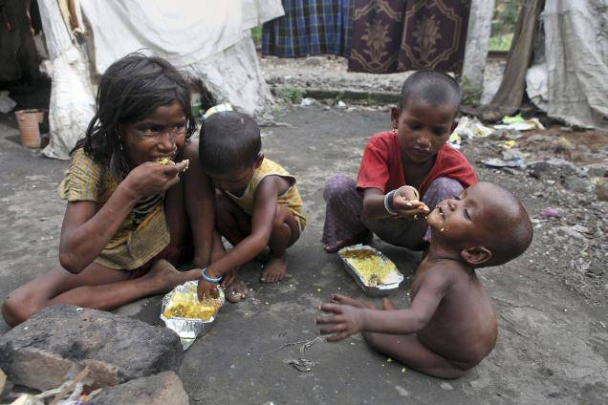
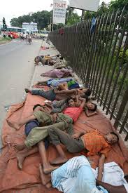

Slide 10
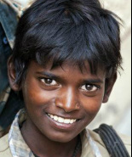

Unit 7 lesson 4

Slide 11
Learning outcomes:
By the end of the lesson students will learn ----
About the life of a street child.
About the jobs they usually do for living.

Slide 12
From first paragraph
We come to know why Amerigo becomes a street child.
From second paragraph
We come to know the jobs Amerigo does.
From third pargraph
We come to know his friend dies.
From forth paragraph
We come to know what happens one of his friends who worked in a glass factory.
From the fifth paragraph
We come to know the problems Amerigo faces.

Slide 13
Answer the following questions:
What is your impression about Amerigo’s father?
What was Amerigo’s first job? What made him stop
it?
How is Amerigo’s experience of selling ice cream?
What does Amerigo desire now?
What should the society do for children like Amerigo?

Slide 14
Answer of the above questions:
I hate Amerigo’s parents. They should love their child, rather they left him. They have violated human rights which made Amerigo a street child.
The collecting of trash and selling them to the vendor. Serious infection made stop it.
The work of selling ice cream for Amerigo was very difficult and painful.

Slide 15
Amerigo now desire to live his own home and sleep there because sleepin on the street is not safe.
e) The society should rehabilitate street children and ensure their fundamental rights.

Slide 16

Home work
Write a paragraph on
Street Children

Slide 17
Thank you

